Slide 1
UAV Ground Detection
Distinguish Tree Species
Christian Ekeigwe, Daehyeon Jeong, Jaeyeong Shim, Jeonghwan Kang, Seoungheong Jeong
Project 17

Slide 2
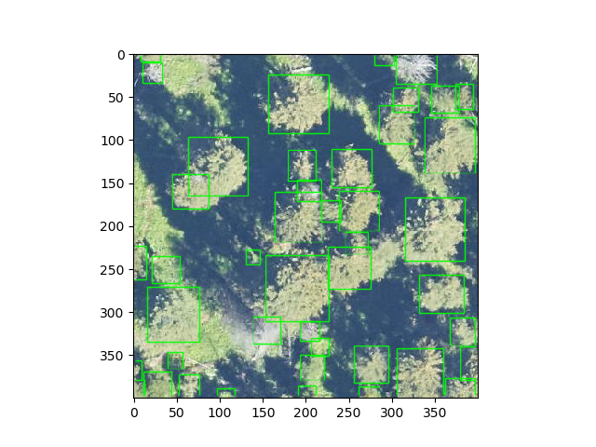
Detecting Tree model
Deep Forest
Training and predicting individual tree airborne RGB image
https://deepforest.readthedocs.io/en/latest/landing.html

Slide 3
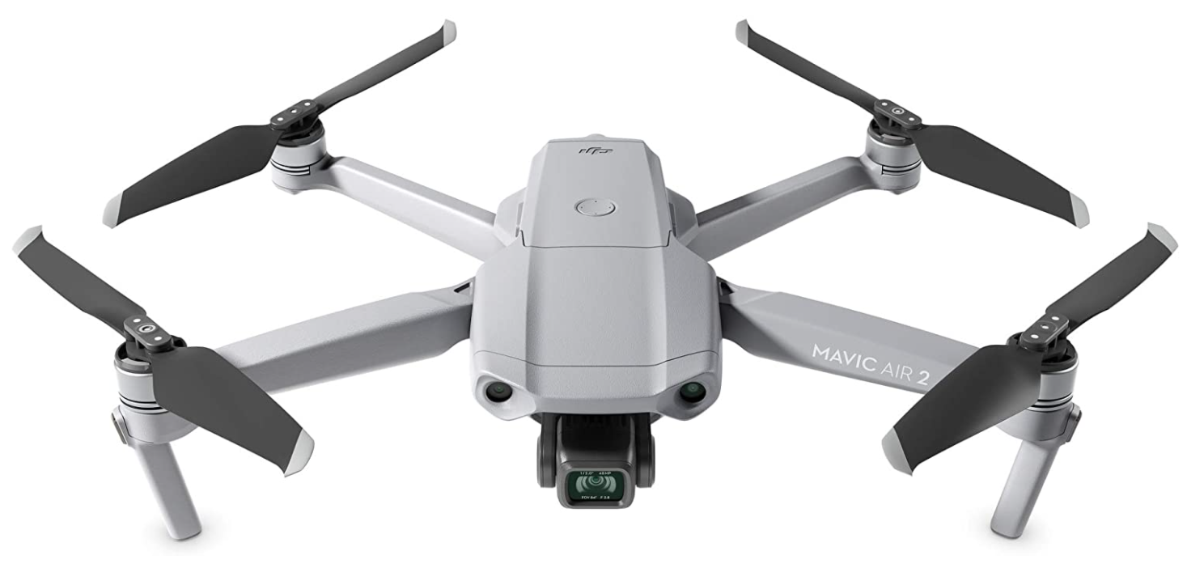
Collecting data using UAV
Collecting data using UAV
But we think it is hard to use UAV in Korea forest and gathering data.
We have some several problems
So, we try to find some new method.

Slide 4
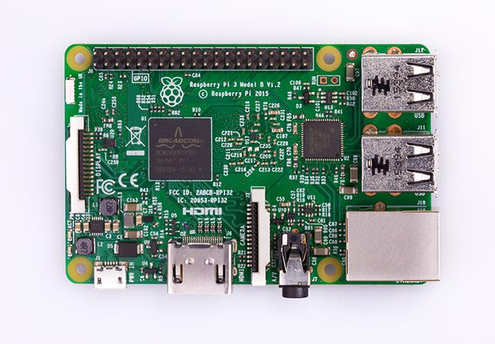
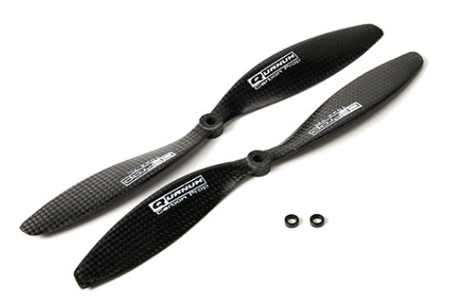
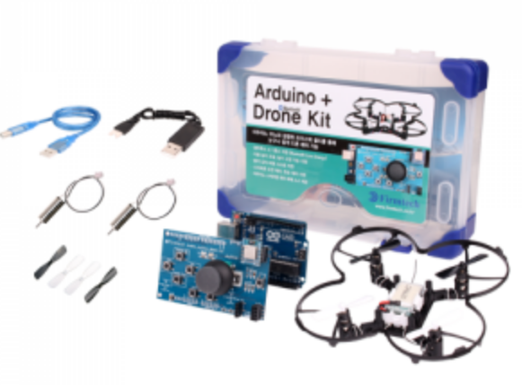
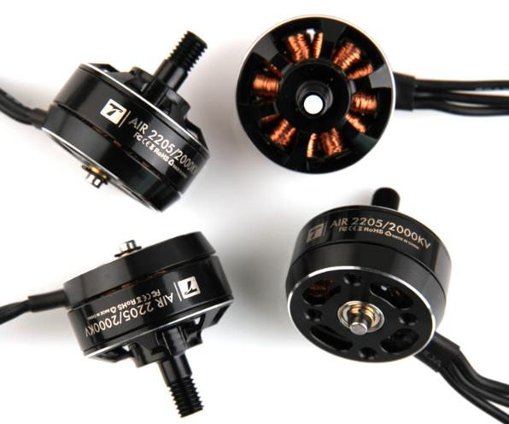
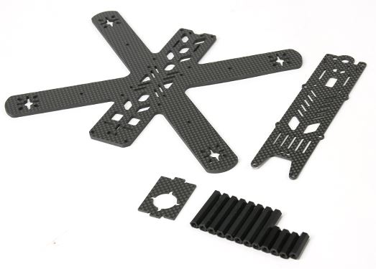
Solution 1
What about UAV?
We have to build drones

Slide 5



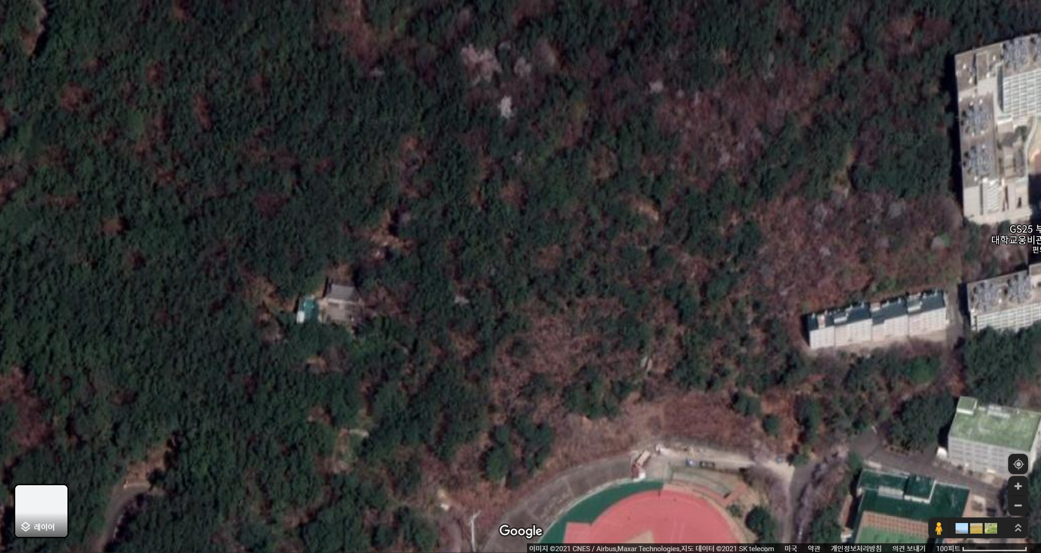
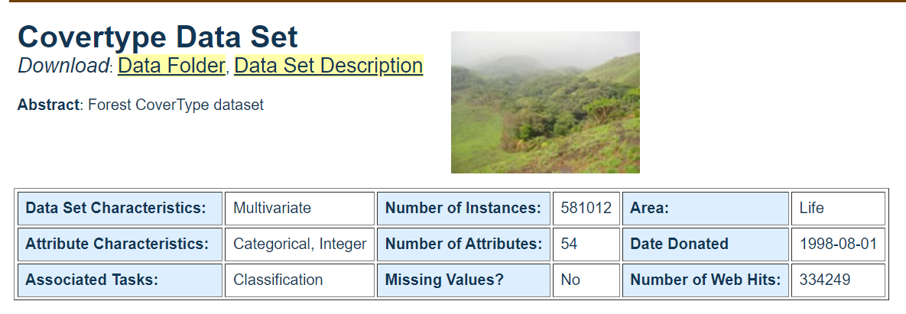
Solution 2
How do we collect map data?
From Google Map API
External Dataset

Slide 6
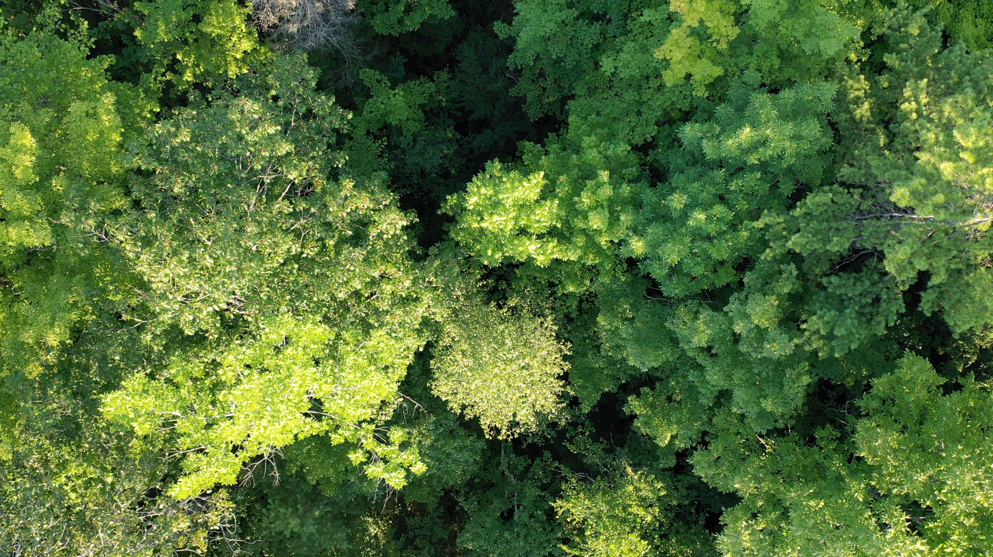
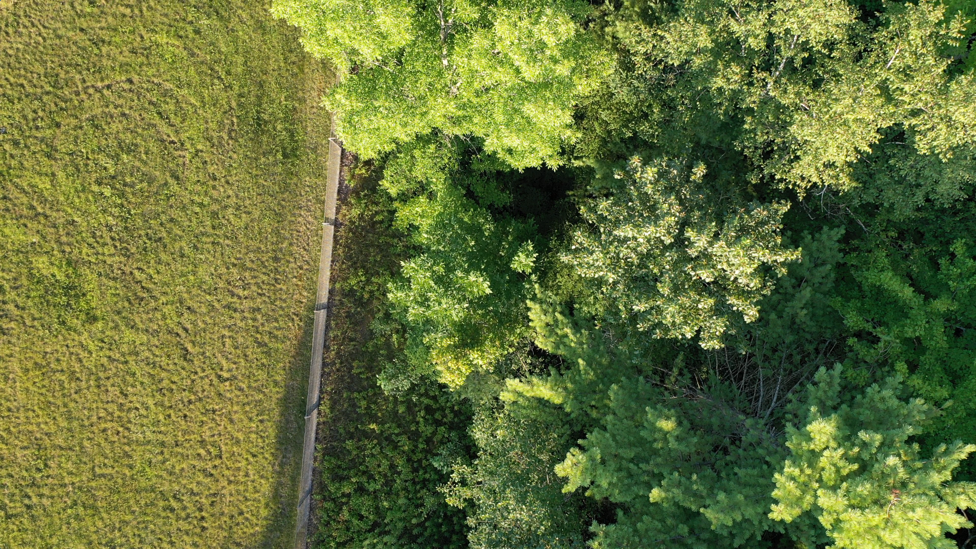
Data
The video capture shot we get from Purdue

Slide 7
Plan
Step 1
Get data from video
Make modeling system
Classify data
(Distinguish Tree Species)
Modeling data
Step 2
Real time receive data from UAV
Add/Del data from GEO chart
Step 3

Slide 8
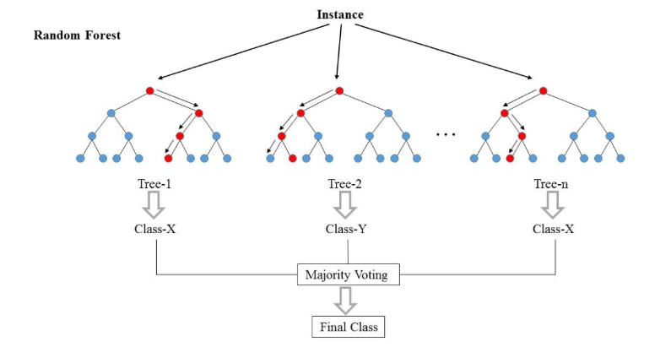
Step 2
Classify data
(Distinguish Tree Species)
Modeling data
Classification
Notes:
Basically, the main gold of this project is to classify trees, so we will drill down into the algorithm of classification, such as KNN, Decision Tree, Random Forest, Naïve Bayes, SVM and else. I guess it’s almost impossible to choose the perfectly matching algorithms that produce the best result for the first time. We will just have to keep repeating and tuning them.

Slide 9
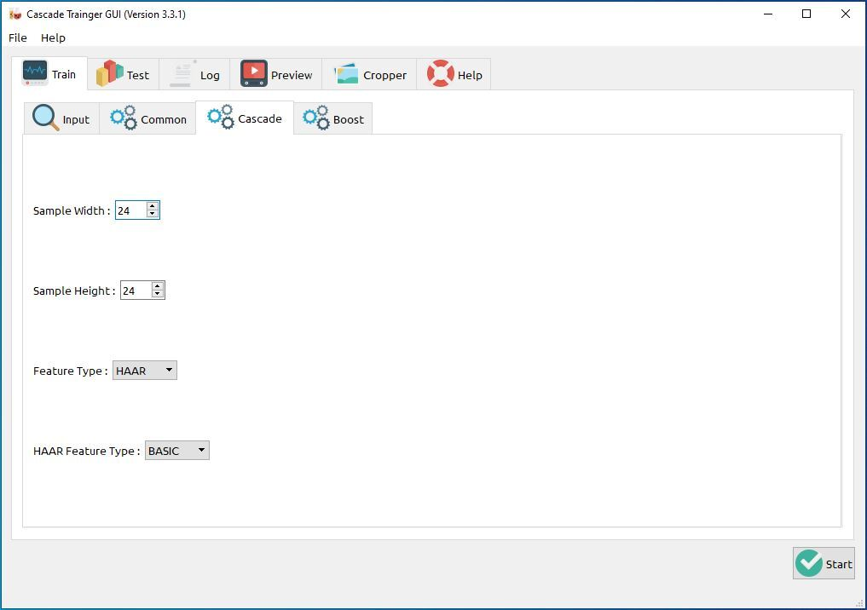
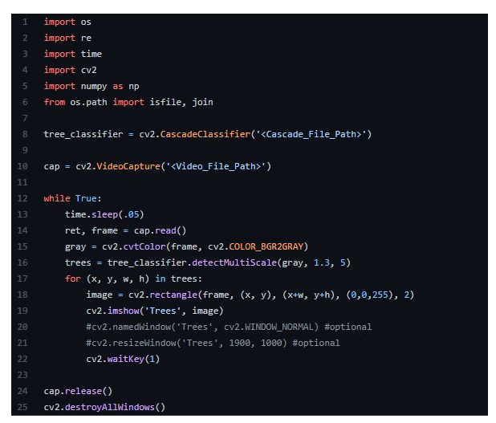
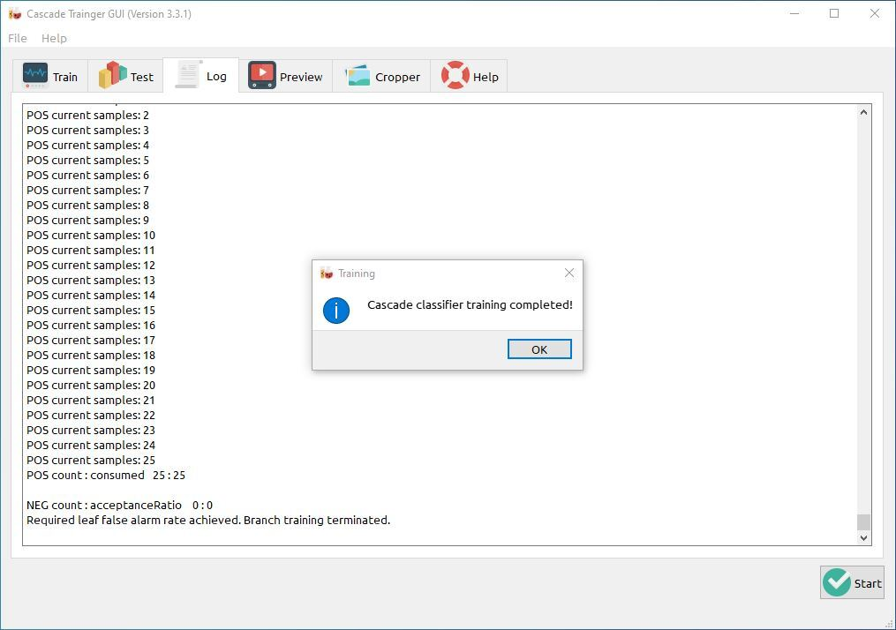
Classify Data
Detecting images from video
CascadeTrainer

Slide 10
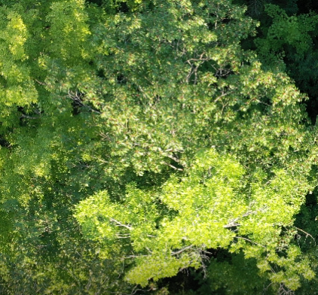
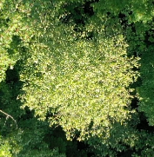
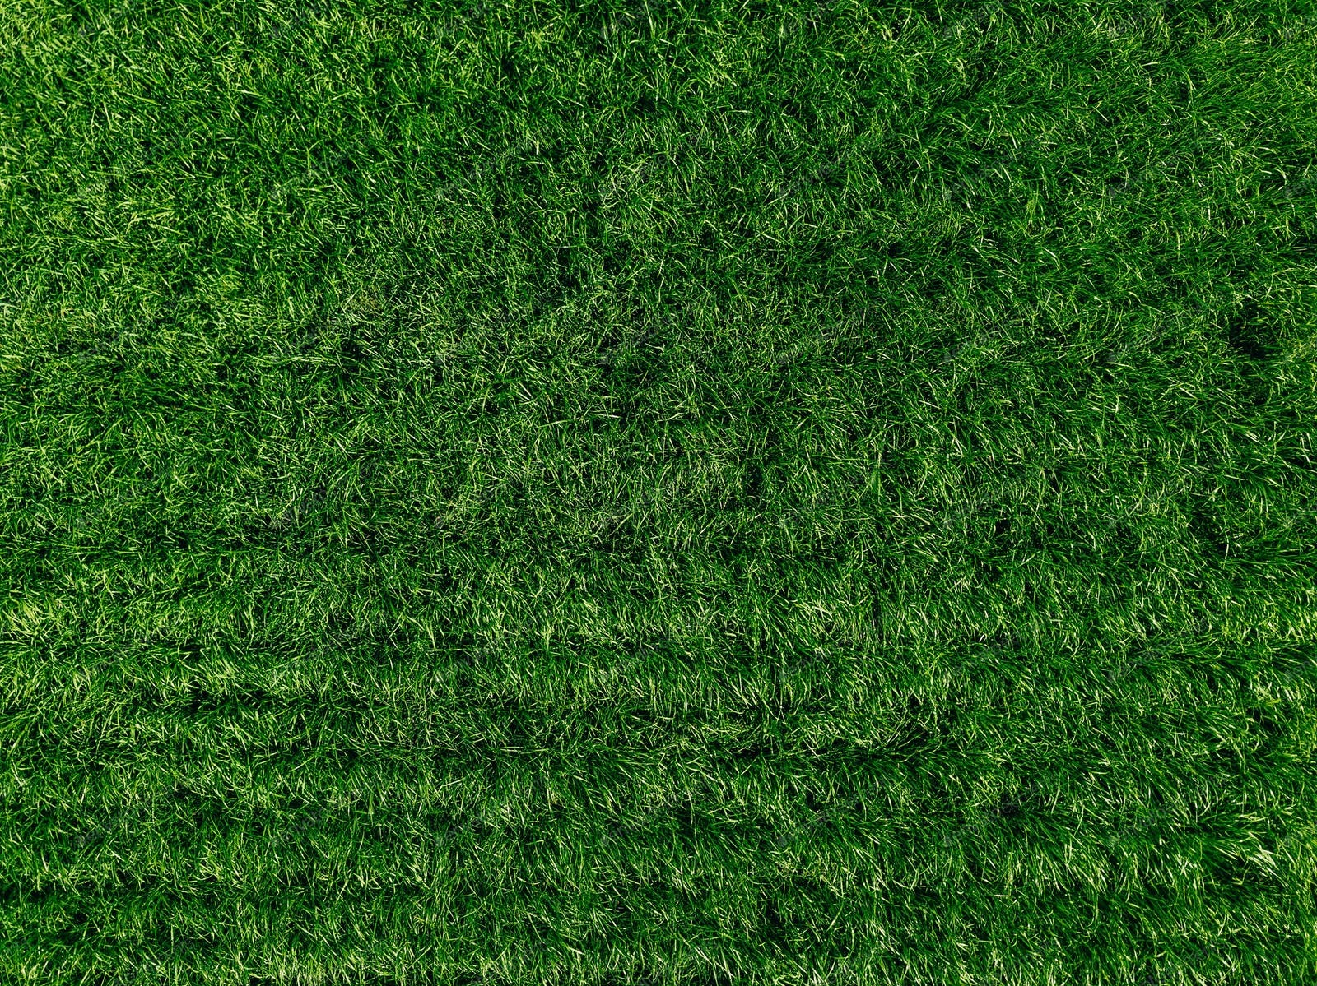
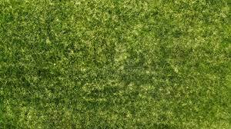
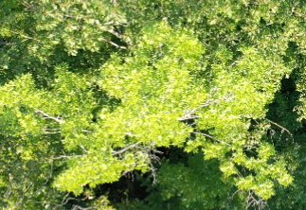
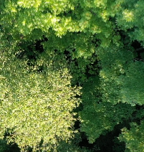
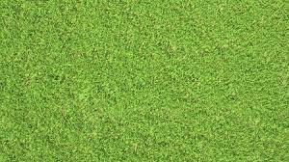
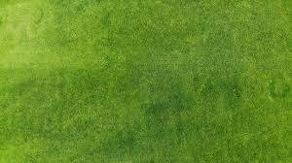
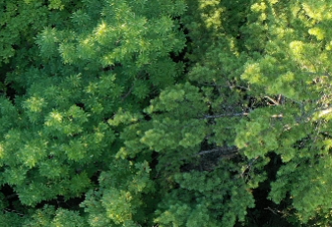
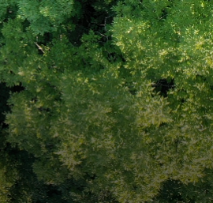
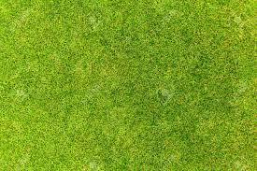
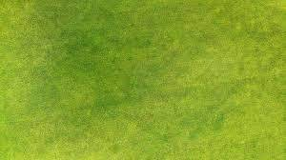
Image Labeling
Positive
Negative

Slide 11

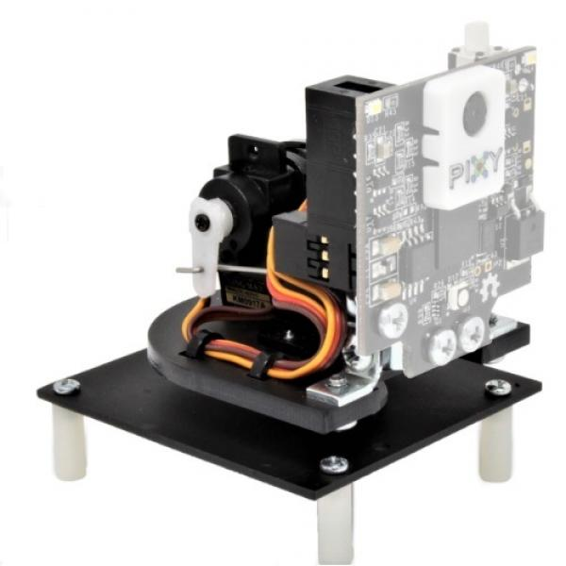
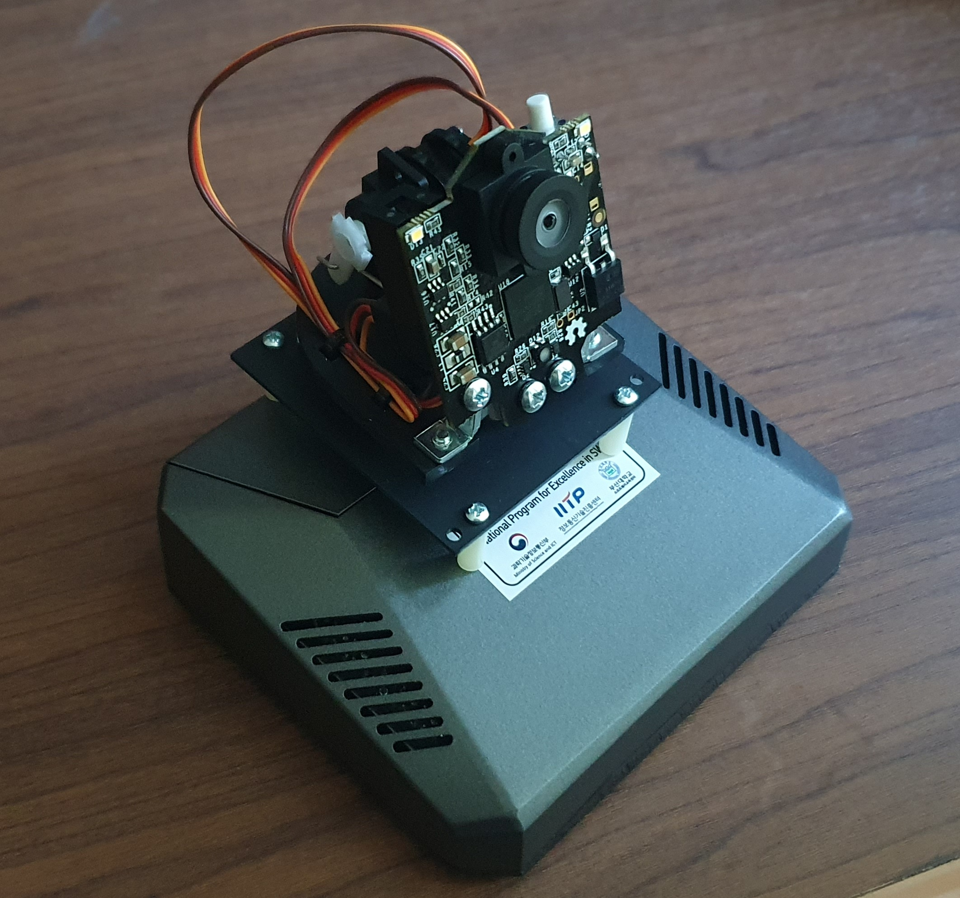
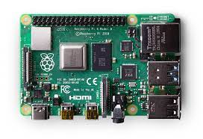
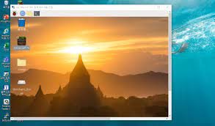
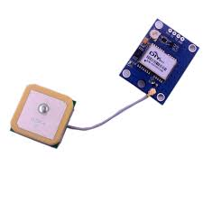
NEXT
Real time communication
DataBase
Remote control

Slide 12
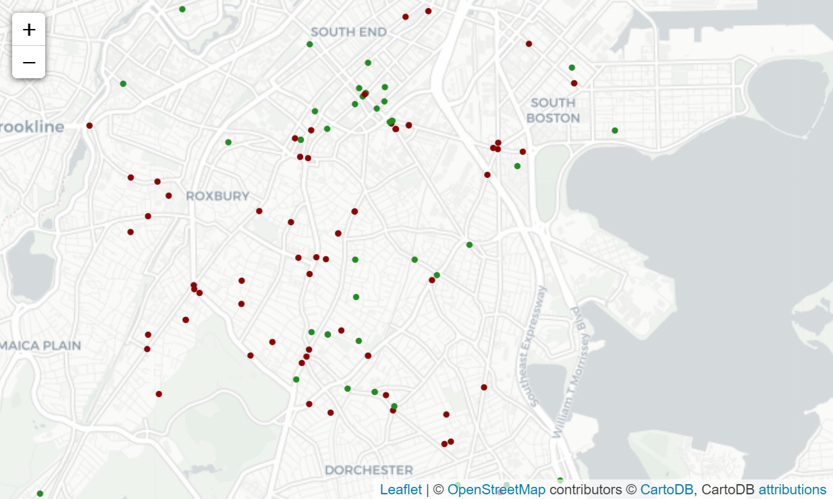
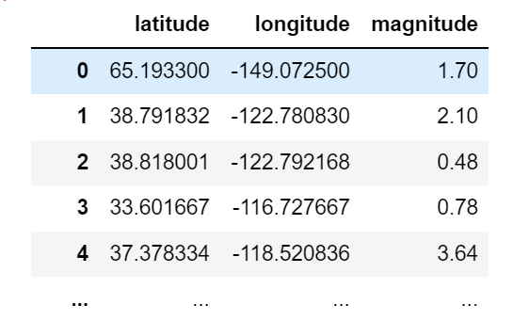
Step 3
Data Visualization
Marker on Map
Notes:
The last step is Data visualization which presents the final outcomes in a simpler way, which is very important. There will be many ways to visualize the data, but intuitively, we are considering marking the types of trees by color on the map. If we can sort out trees and obtain the data of the latitude and longitude for each tree, it’s available to mark on a map with Python ‘folium’ library.
The whole series of processes I mentioned will be done by Python and I expect to automate the sequence.
Thank you for listening.

Slide 13
Thank you
Questions?

